Slide 1
Slide 1: Team Members
Book Recommendation System
Group - II Members:
K Mohammad
MR.S.MADESHWARAN
MR.S.NITHISH
Tumma Shivkumar Ashokrao
Ms. ANJALI AWADHESH PAL
Ms. Arati Shankar Padwal
Mr.K. Mohammed Kaif

Slide 2
Title: “Resume classification - Group 2"
Subtitle: “Final PPT"
Your Name: K Mohammad
Date: 22/02/2024

Slide 3
Slide 3: Agenda
Brief overview of the topics to be covered.
I - Data Set Details
Abstract
Text Extraction from resumes
II - Exploratory Data Analysis (EDA)
Data Visualization
III - Model Building
Model Evaluation
IV - Model Deployment
V - Conclusion

Slide 4
I . Dataset Details
Abstract
Text Extraction from resumes

Slide 5
ABSTRACT
A resume is a brief summary of your skills and experience. Companies recruiters and HR teams have a tough time scanning thousands of qualified resumes.
Spending too many labor hours segregating candidates resume's manually is a waste of a company's time, money, and productivity. Recruiters, therefore, use resume classification in order to streamline the resume and applicant screening process.
NLP technology allows recruiters to electronically gather, store, and organize large quantities of resumes. Once acquired, the resume data can be easily searched through and analyzed.
Resumes are an ideal example of unstructured data. Since there is no widely accepted resume layout, each resume may have its own style of formatting, different text blocks and different category titles.
Building a resume classification and gathering text from it is no easy task as there are so many kinds of layouts of resumes that you could imagine.

Slide 6
Overview and Data Extraction
Objective: Automate HRM processes, minimize manual effort, and enhance accuracy.
Steps:
Import necessary libraries (spaCy, textract).
Extract text from different categories (PeopleSoft, React JS Developer, SQL Developer, Workday resumes).
Create a consolidated DataFrame for further analysis.

Slide 7
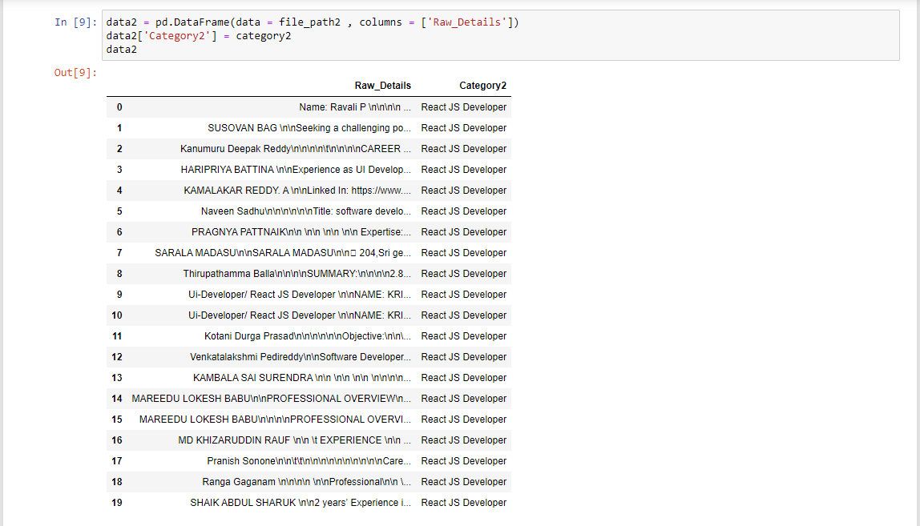
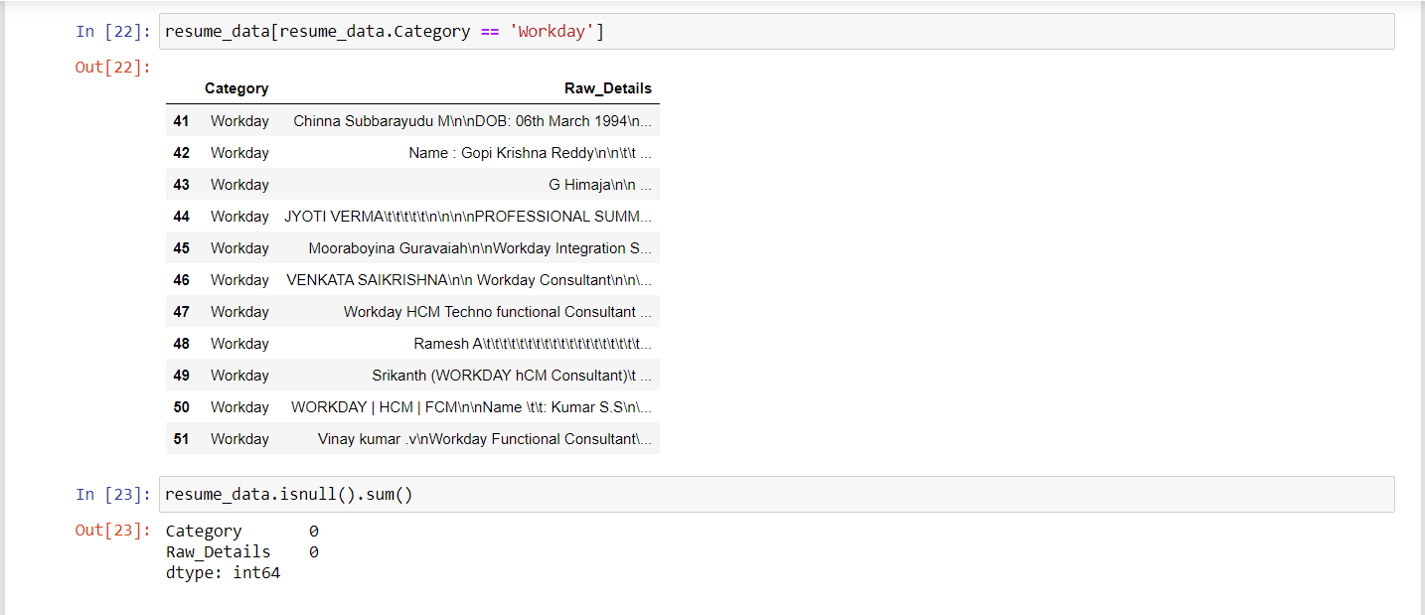

Slide 8
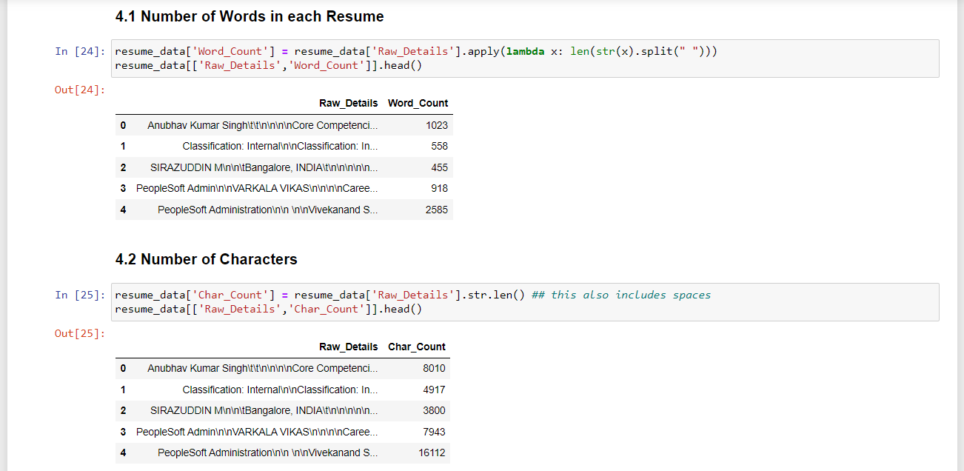
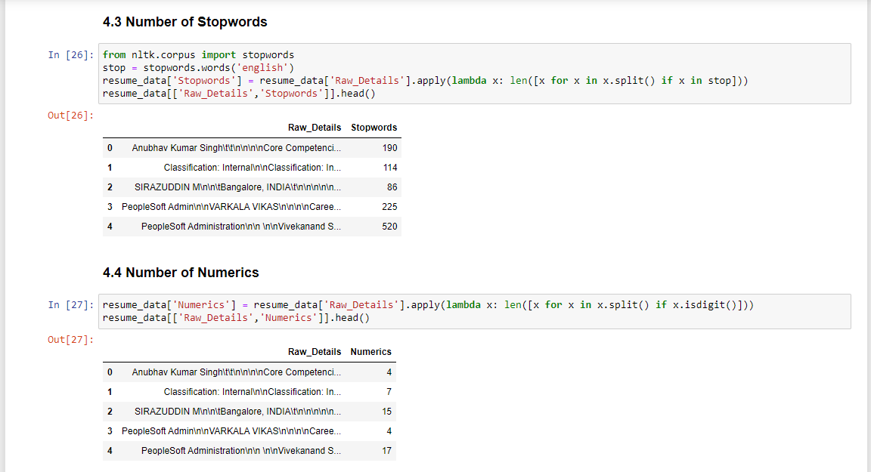

Slide 9
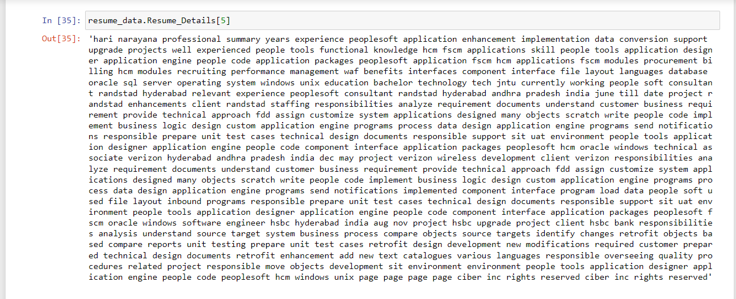
Data Analysis and Pre-Processing
Slide 2: Data Analysis and Pre-Processing
Insights:
Analyze word count, character count, stopwords, and numerics in the resumes.
Apply text pre-processing techniques to clean the data.
Visuals:
Sample data table displaying word count and character count.
Code snippet for text pre-processing.
Visualizations of data insights (charts).

Slide 10
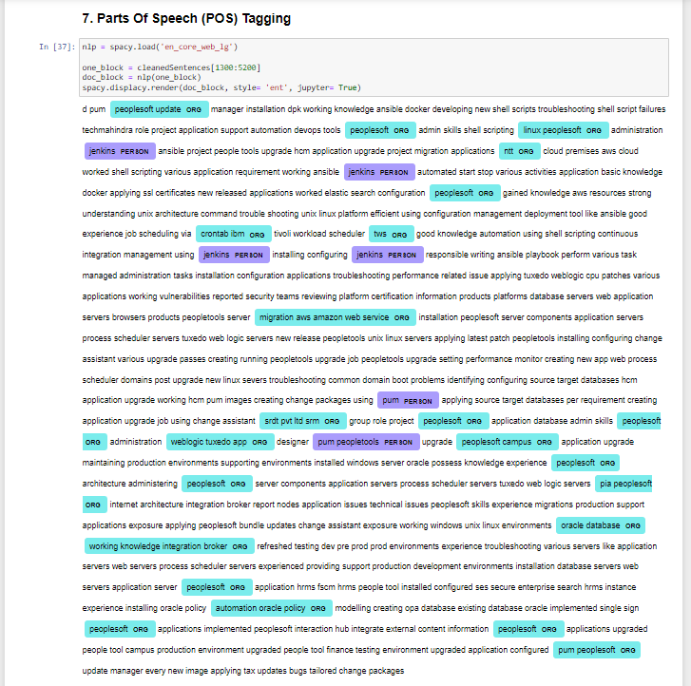
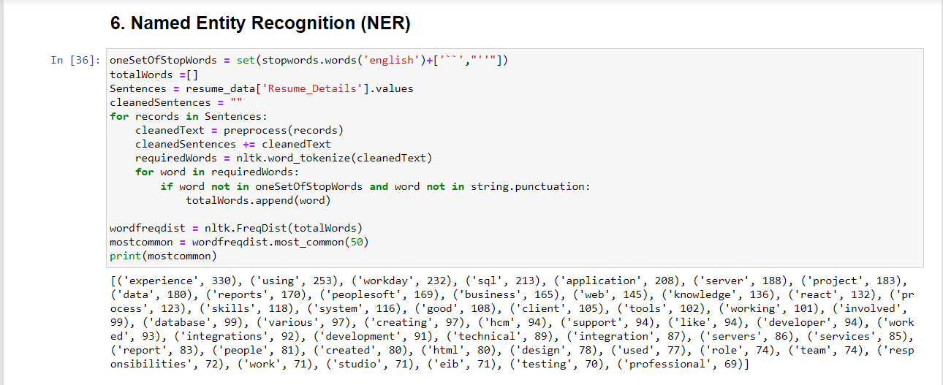

Slide 11
II . Exploratory Data Analysis (EDA)

Slide 12
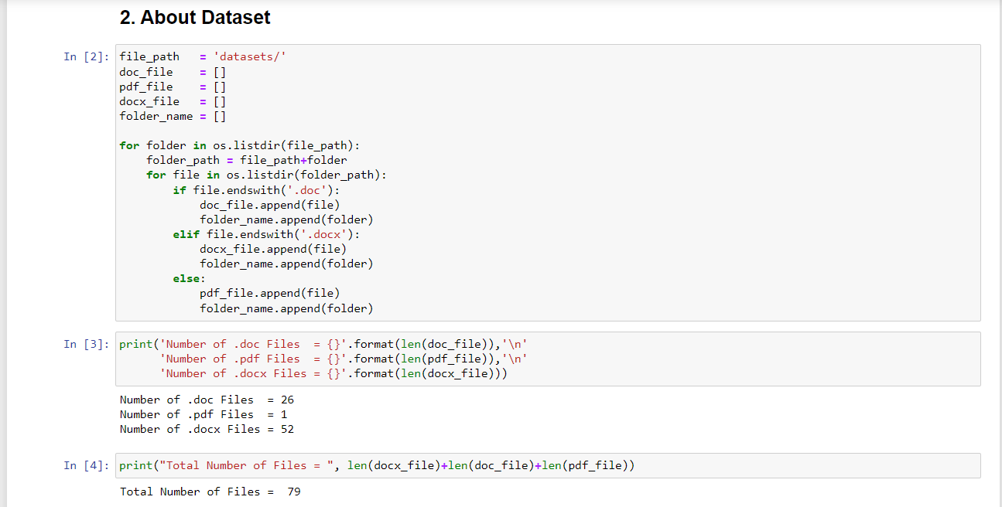
2.1: Introduction and Dataset Overview
Business Objective:
Automate HRM processes.
Achieve higher accuracy and automation with minimal human intervention.
Library Import:
Basic Libraries: os, spacy, docx2txt, numpy, pandas, seaborn, matplotlib.
Text Processing Libraries: TextBlob, stopwords, WordCloud, CountVectorizer.
Dataset Information:
Types of Files: .docx, .doc, .pdf.
Distribution of file types.

Slide 13
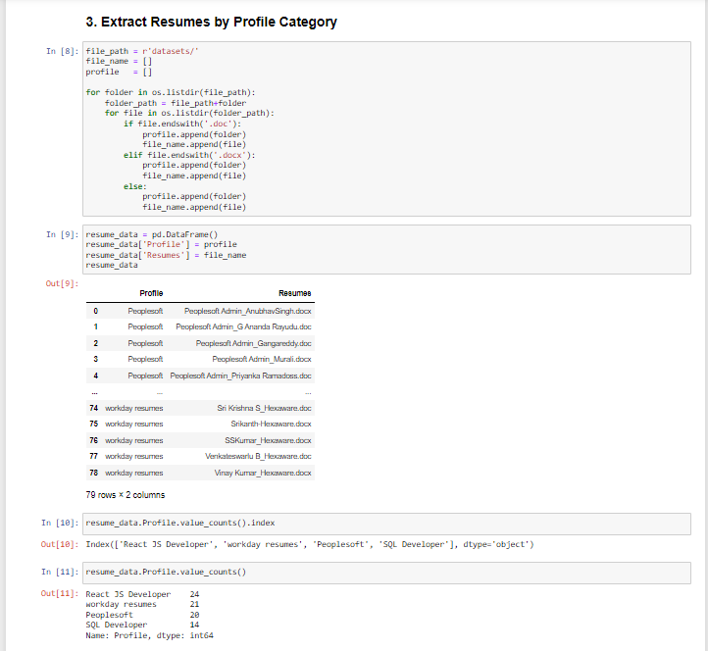
2.2: Profile and Resume Distribution
About Dataset:
Explore the dataset.
Number of resumes in each profile category.
Visuals:
Bar chart illustrating the number of profiles.
Pie chart showing the percentage of profiles.
Code Snippets:
Code for extracting and categorizing resumes.
Visualization of profile distribution.

Slide 14
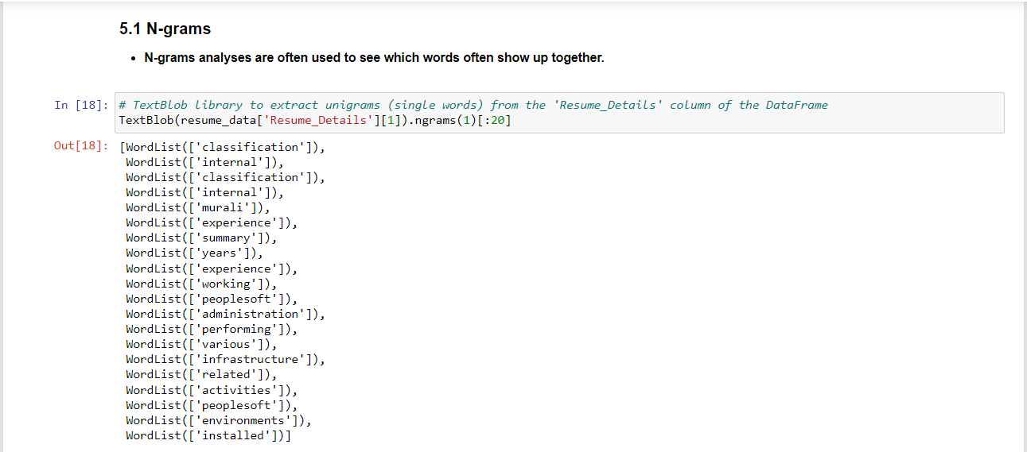
2.3: Data Exploration and Analysis
Resume Reading:
Function to extract text from .docx files.
N-grams Analysis:
Unigrams, bigrams, and trigrams exploration using TextBlob.
Top Words Analysis:
Using CountVectorizer to find the most used words.
Visualization of the top 25 words.
Word Cloud:
Word cloud visualization of the most common words in resumes.

Slide 15
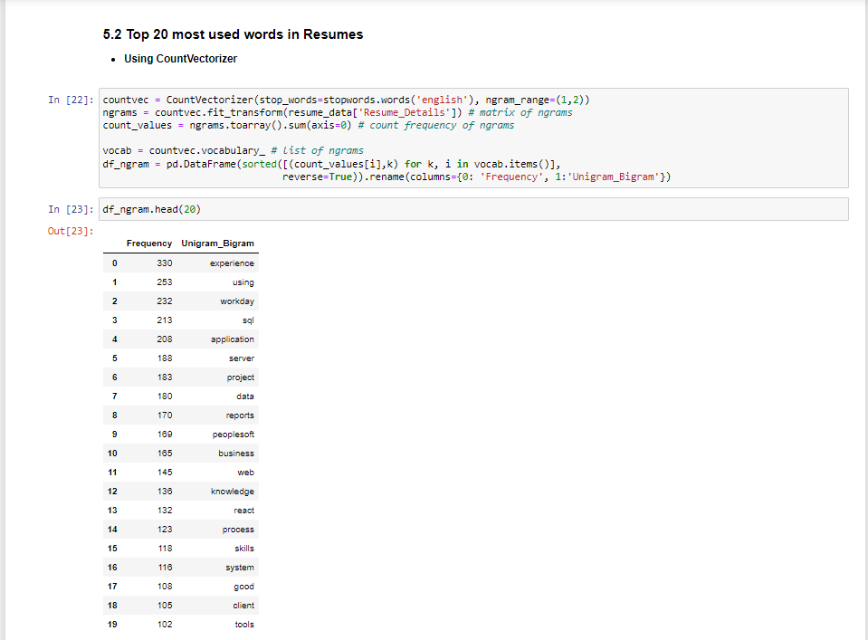
2.4: Conclusion and Next Steps
Insights:
Overview of document classification goals.
Exploration of resume data, file types, and profiles.
Analysis of N-grams, top words, and word cloud.
Next Steps:
Implement document classification algorithms.
Evaluate and fine-tune the model for optimal results.
Continuously refine and enhance the document classification system.
Closing Remarks:
Thank you for your attention!
Any questions or suggestions are welcome.

Slide 16
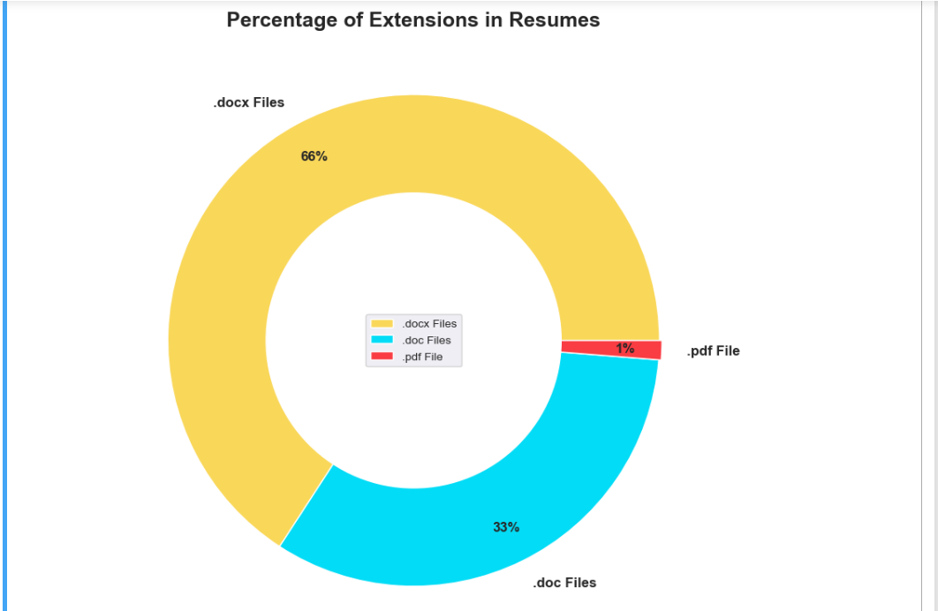
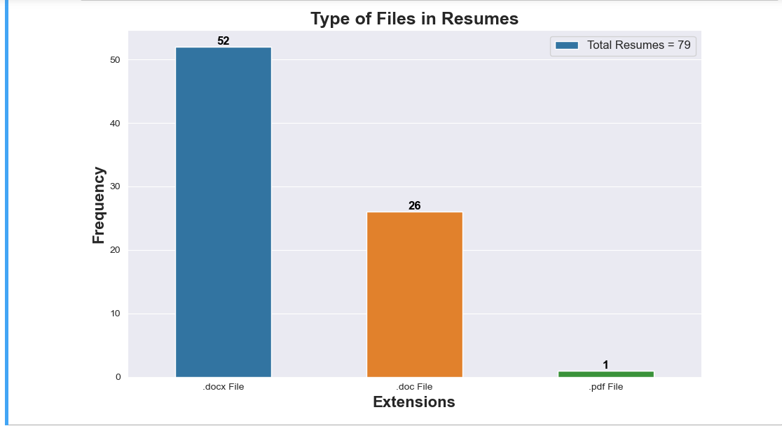
2.1 Data Visualizations

Slide 17
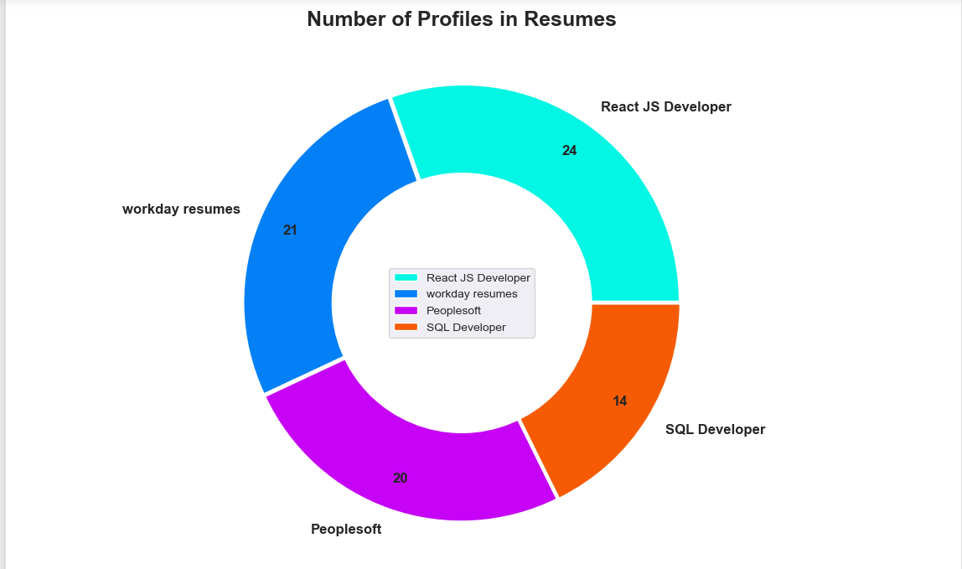

Slide 18
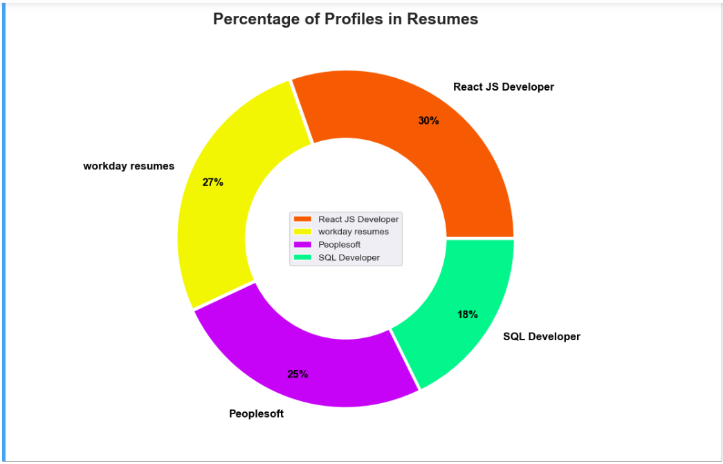
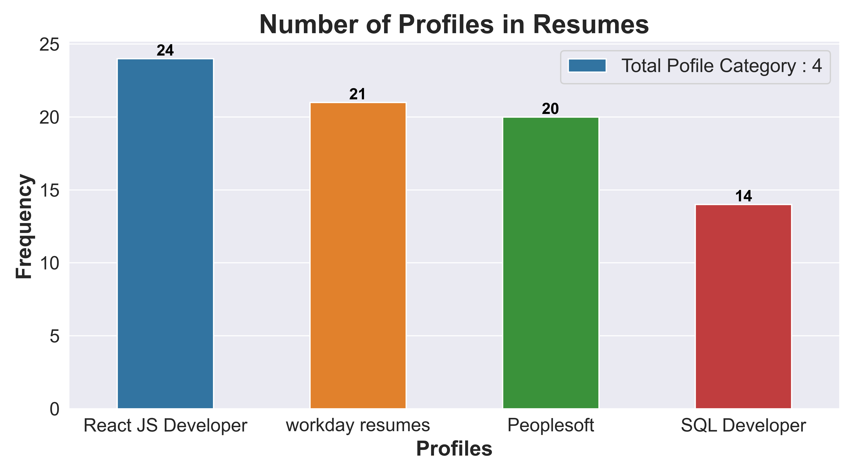
Number of Profiles in Resumes & Percentage of Profiles in Resumes

Slide 19
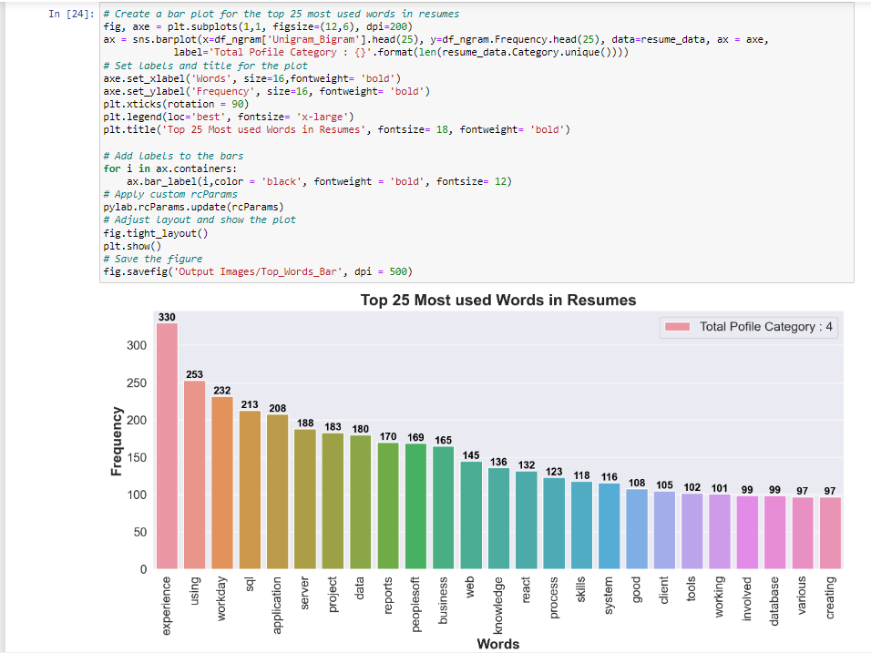
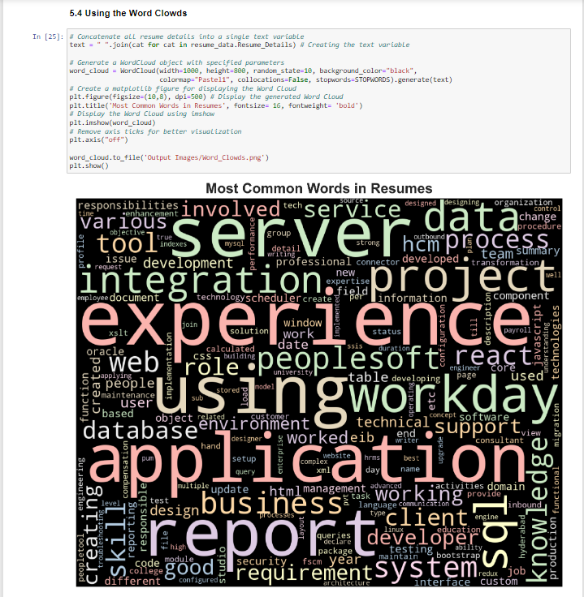

Slide 20
III – Model Building

Slide 21
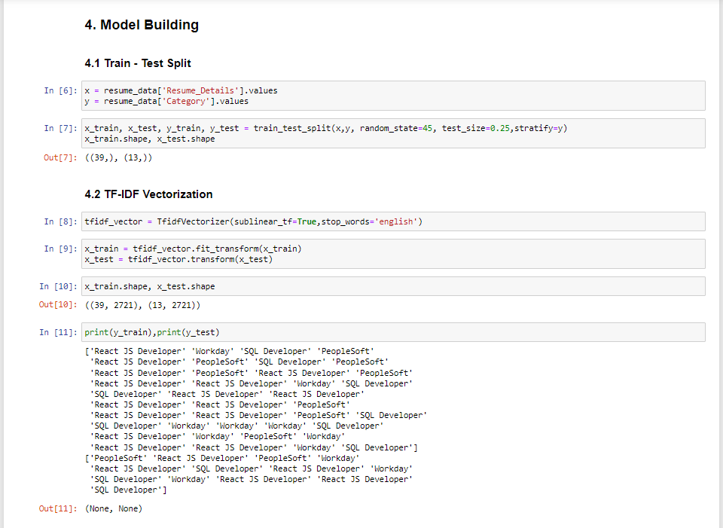
3.1: Introduction and Libraries
Introduction:
Objective: Explore machine learning models for document classification.
Overview of key libraries used in the project.
Libraries Used:
NumPy, Pandas, Seaborn, Matplotlib, Scikit-learn.
Models: SVM, XGBoost, Naive Bayes, Bagging, AdaBoost, Decision Tree, KNN, Random Forest, Logistic Regression, Gradient Boosting.

Slide 22
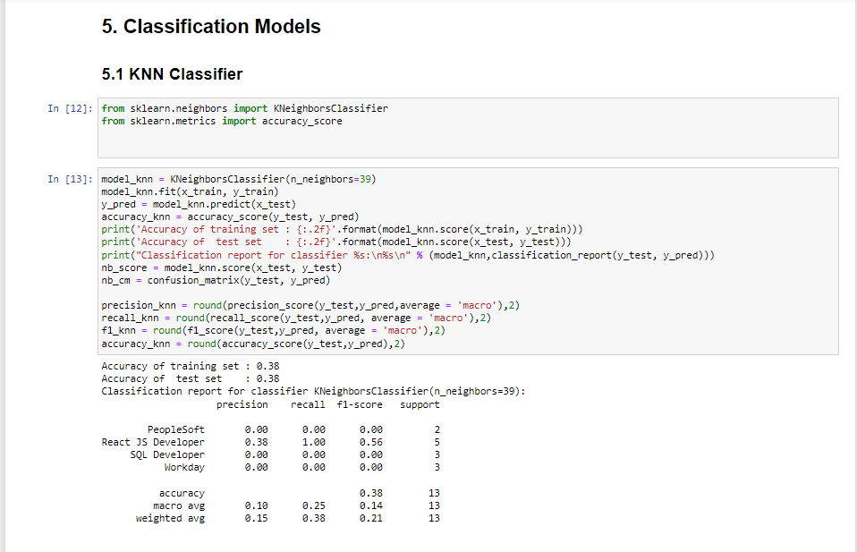
3.2: Data Preparation and Feature Extraction
Data Splitting:
Train-test split to prepare the data.
Feature Extraction:
Utilizing TF-IDF Vectorizer for text data.
Code Snippets:
Demonstrate the process of data splitting and feature extraction.
Include code for TF-IDF Vectorizer.

Slide 23
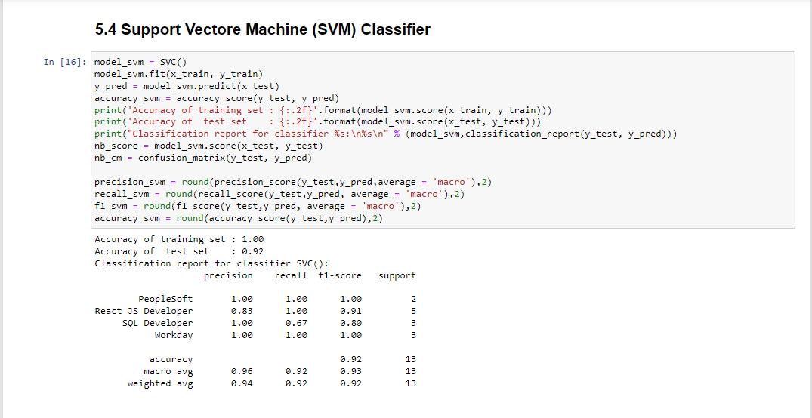
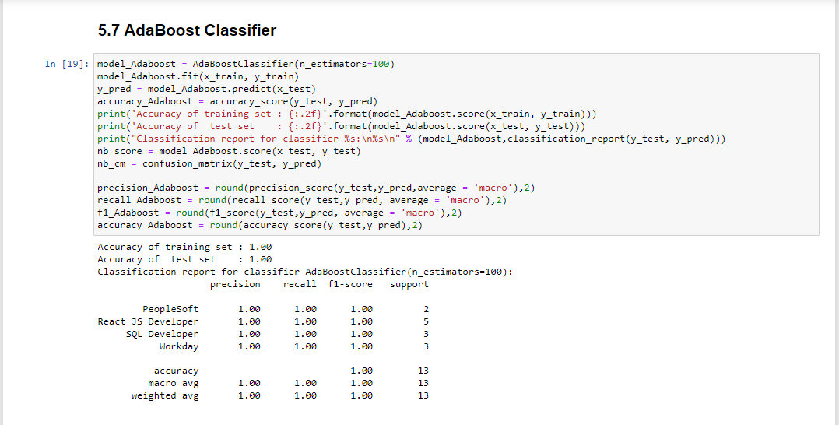

Slide 24
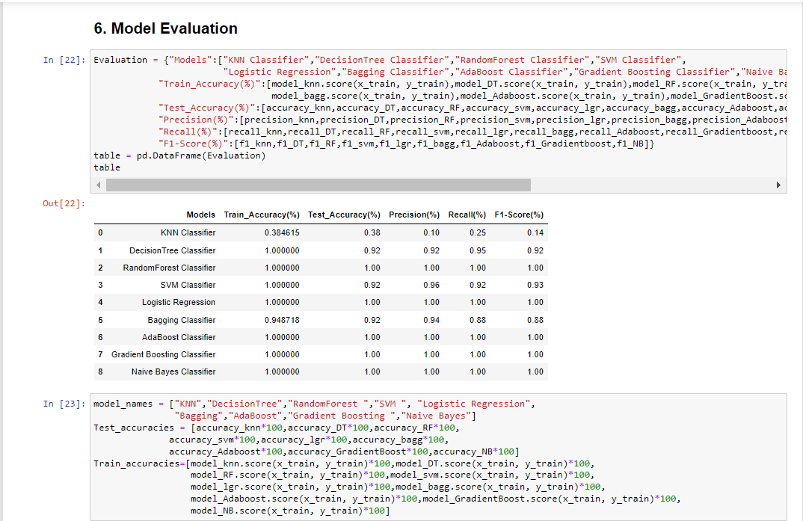
3.3: Model Training and Evaluation
Model Training:
Train a variety of classifiers on the dataset.
Evaluation Metrics:
Utilize common metrics - accuracy, precision, recall, F1-score.
Evaluate confusion matrix for each model.
Code Snippets:
Showcase the code for training multiple classifiers.
Display evaluation metrics and confusion matrix.

Slide 25
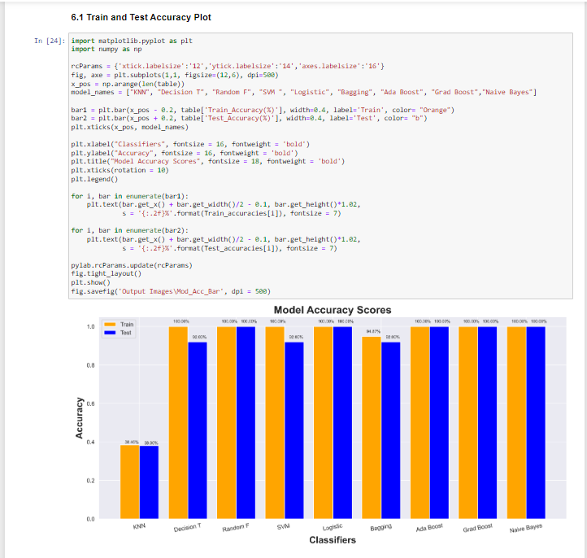
3.4: Comparative Analysis and Next Steps
Model Comparison:
Compare performance metrics of different models.
Highlight strengths and weaknesses.
Next Steps:
Discuss potential improvements or next steps.
Consider hyperparameter tuning or additional feature engineering.
Closing Remarks:
Summarize findings and express readiness for further analysis.

Slide 26
IV - Model Deployment

Slide 27
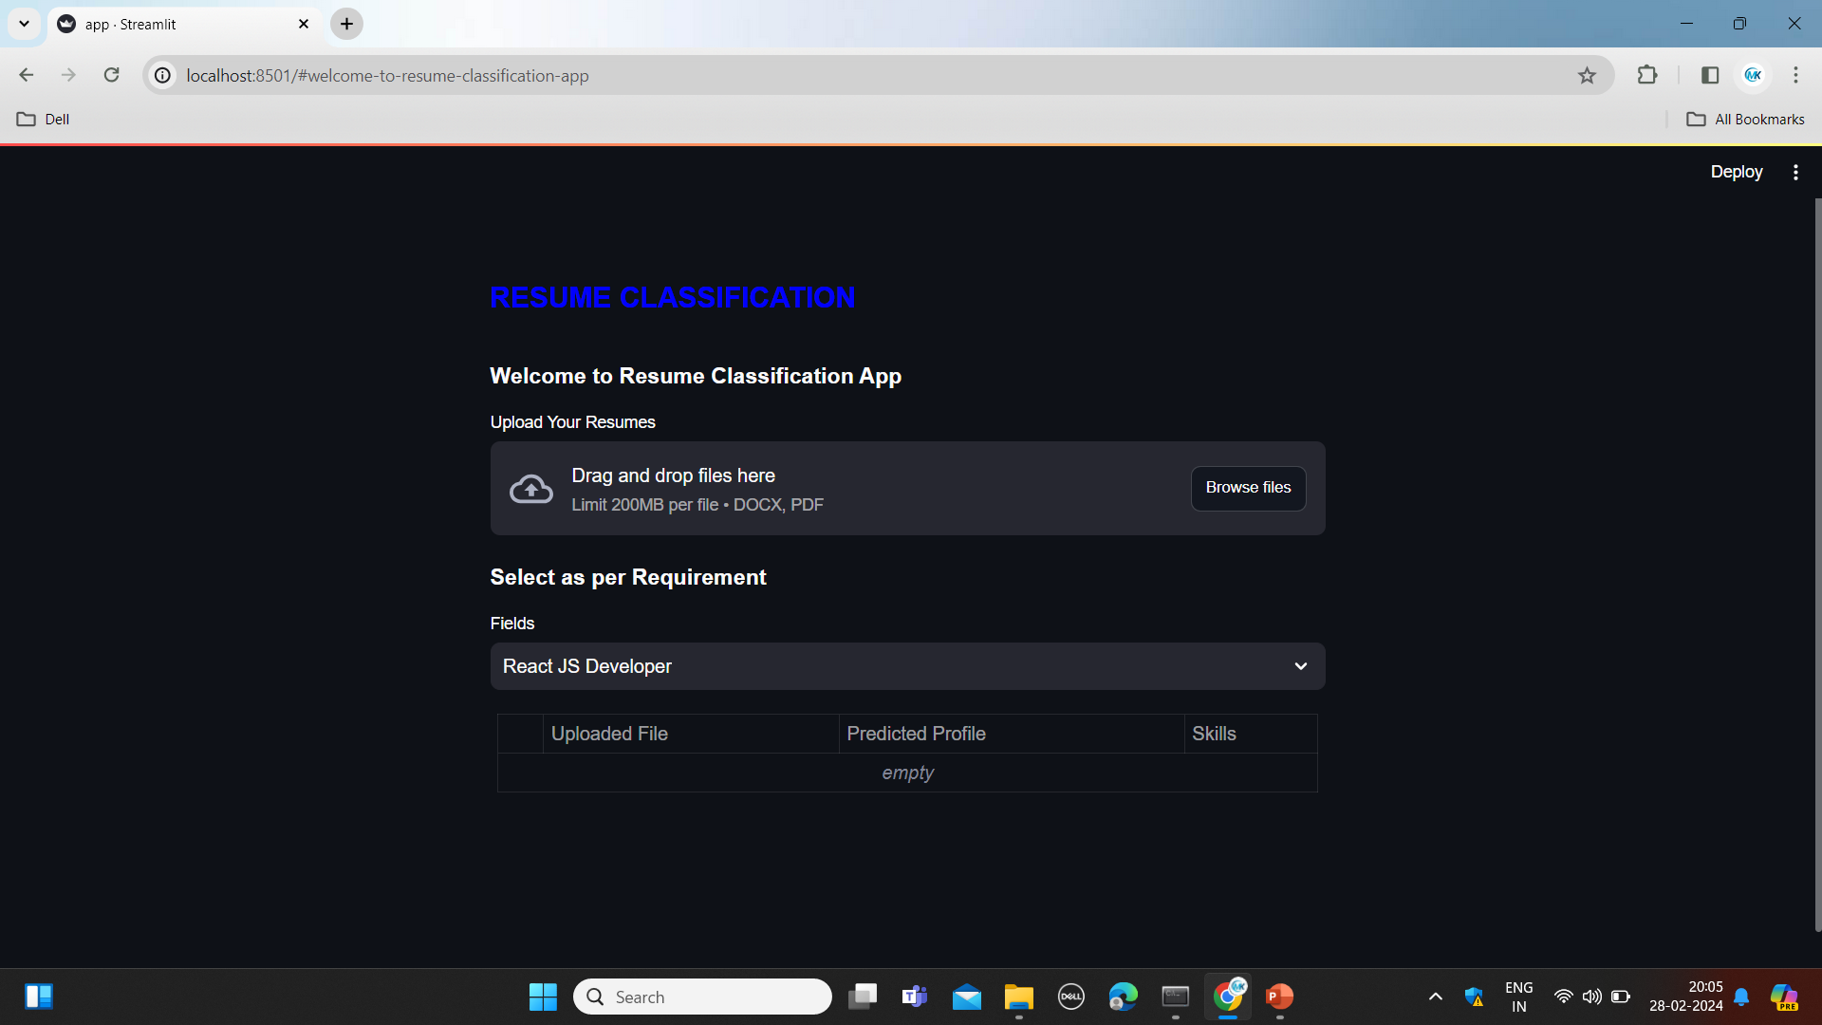
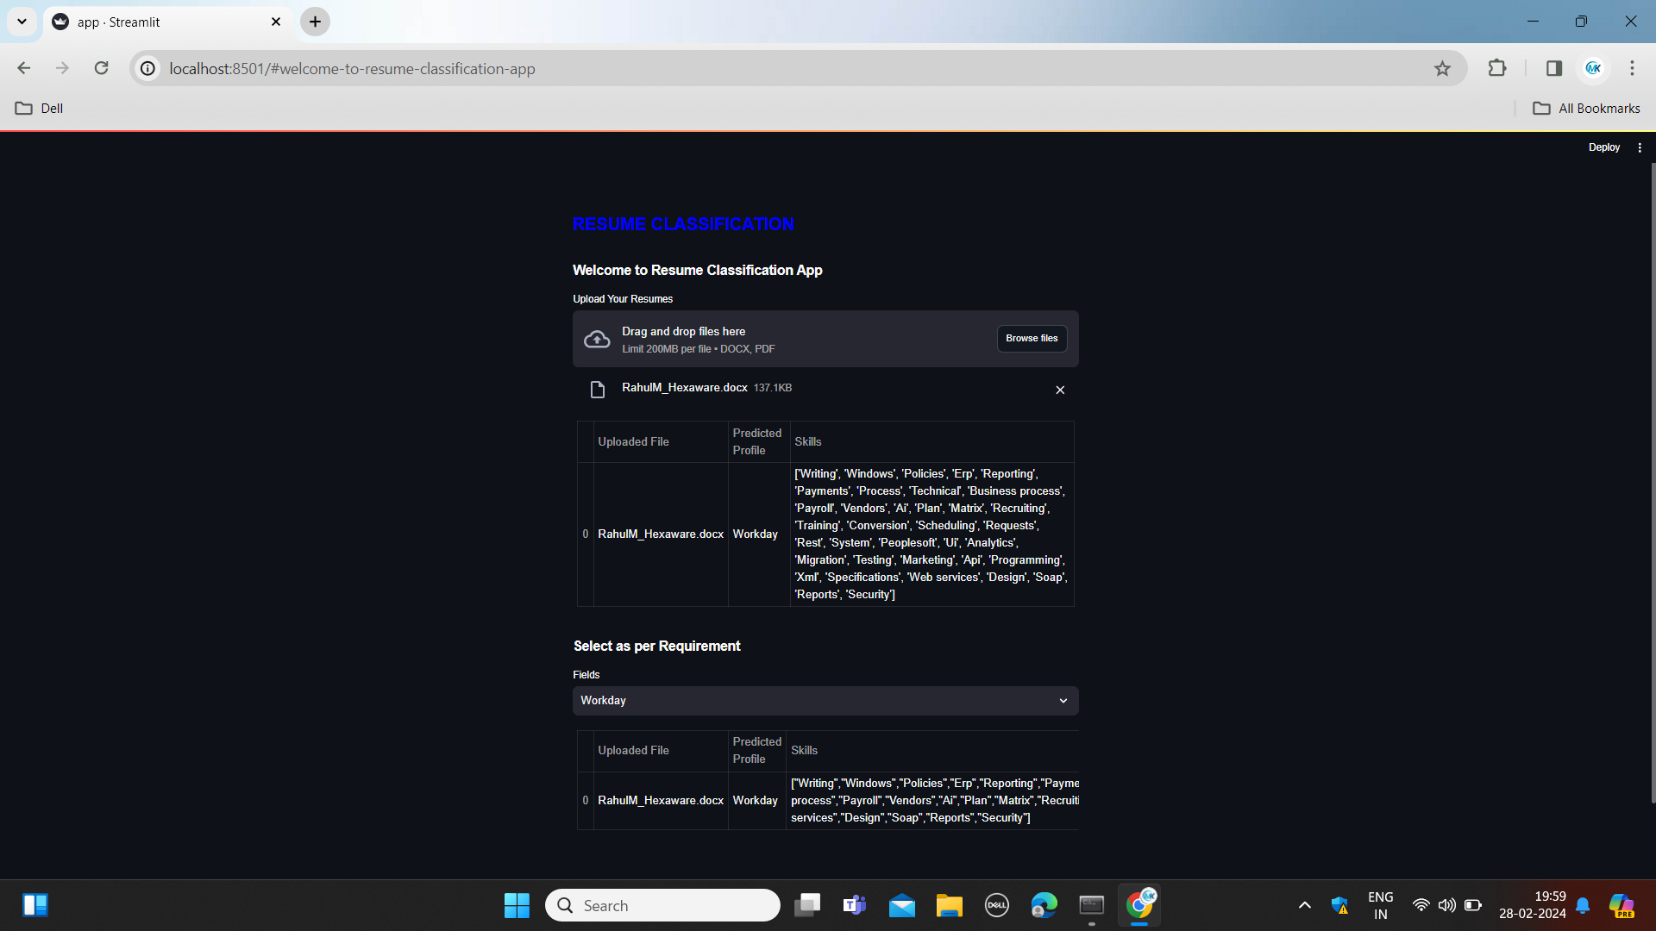
Demo

Slide 28
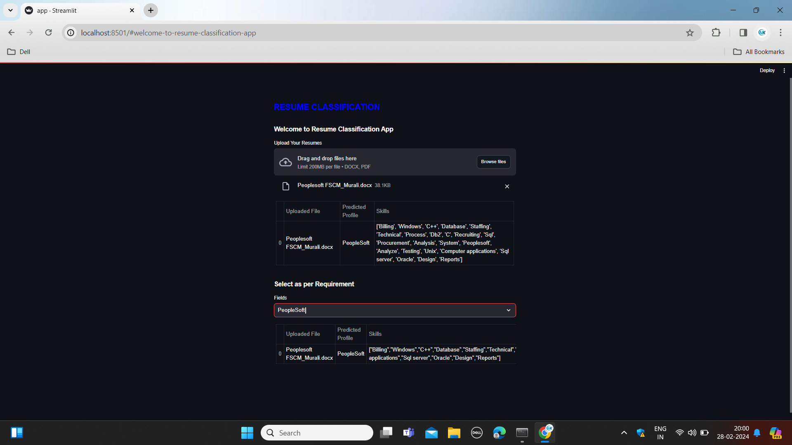

Slide 29
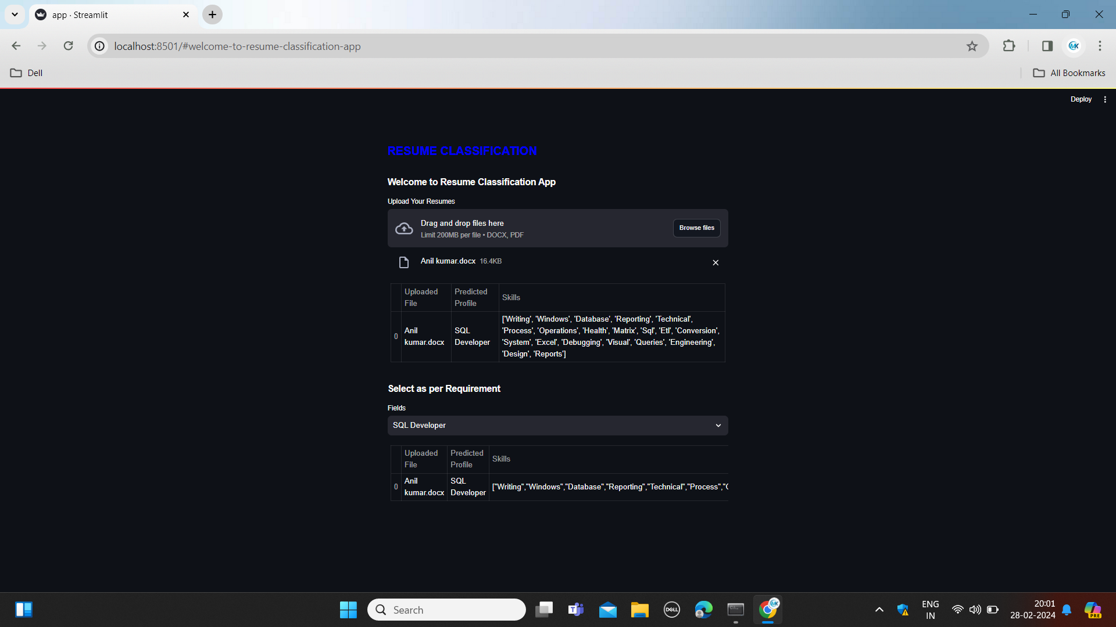
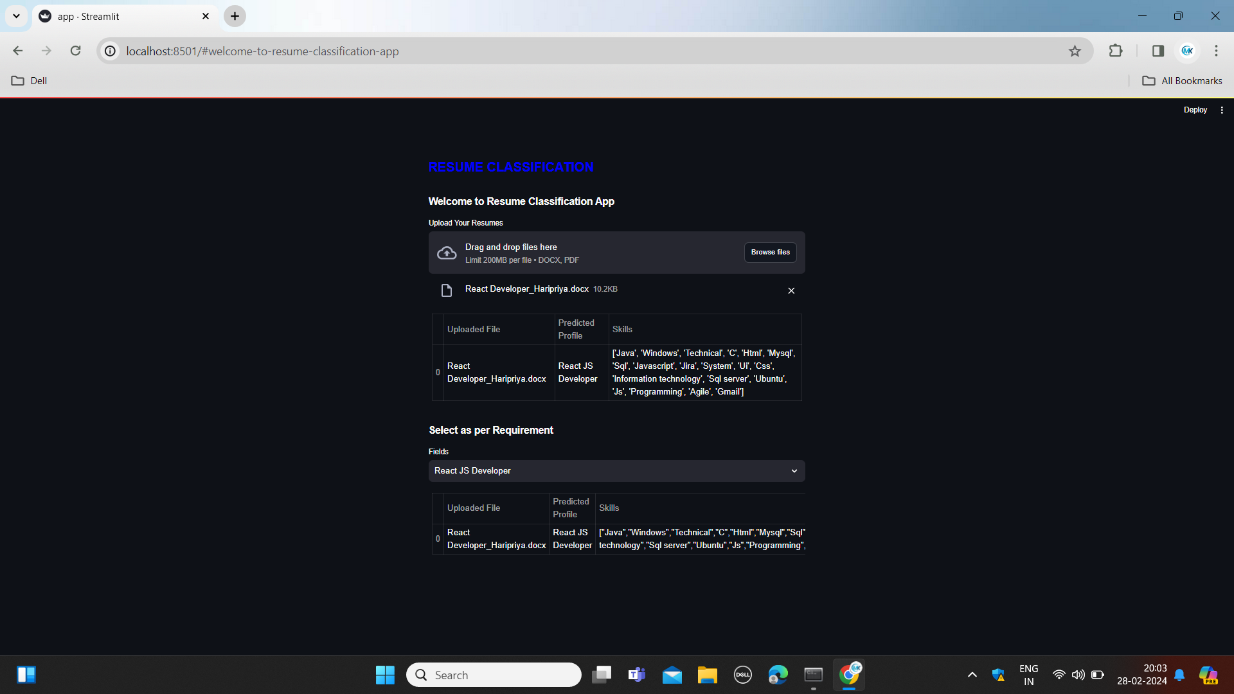
Demo - 1

Slide 30
V : Conclusion
Concluding the analysis, the XG Boost classifier emerged as the most effective model for document classification, demonstrating superior accuracy and precision. This advancement in machine learning models enhances HRM automation, paving the way for further optimizations.

Slide 31
Thank You

